Slide 1
Function apps Research story

Slide 2


Projectanalyse, dia 2
Function app
Trigger
Supported services
Azure Function
Bindings
Connections
Code
Function.json

Slide 3
Projectanalyse, dia 3
Function app
Triggers
Bindings
Supported Services
Connections
Code/
Function.json
1 Trigger per function
Trigger can be an input
Choose trigger when creating function
Trigger
Input Binding
Output Binding
Azure function has support for a list of azure services that it can use as triggers, inputs and outputs.
Configuration within functions
Managed identity
Key Vault
Code file that contains executed code
Function.json is where you define bindings.

Slide 4
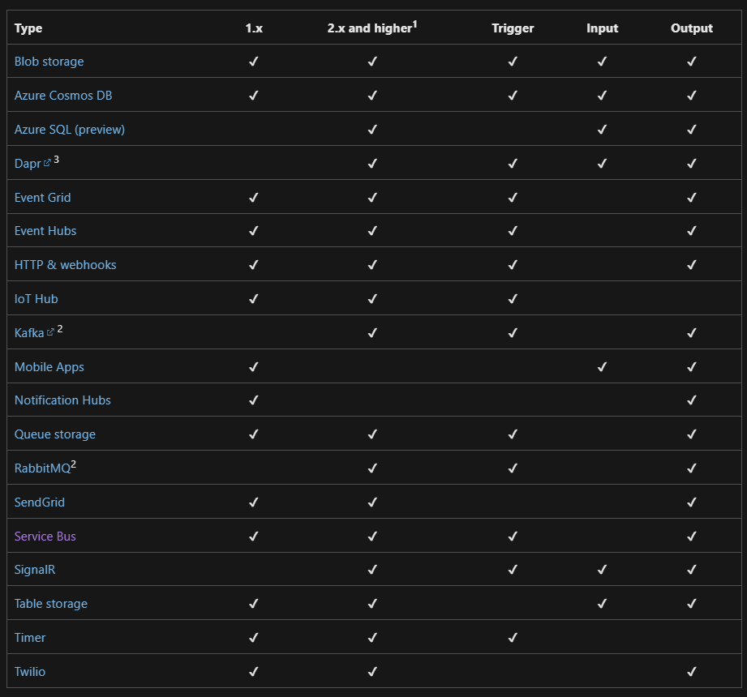
Supported services

Slide 5
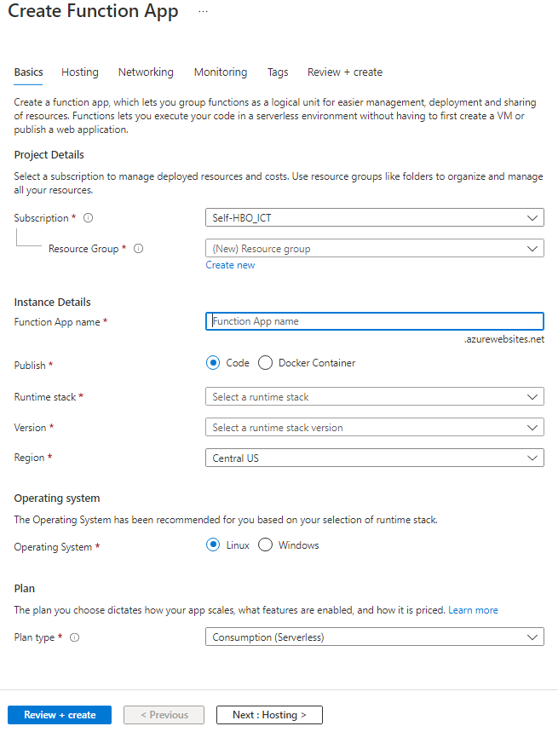
Creating a Function App

Slide 6
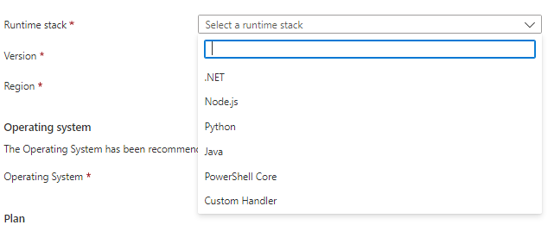
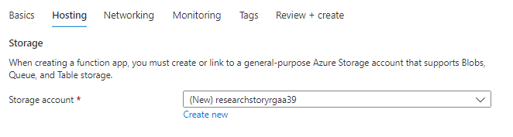
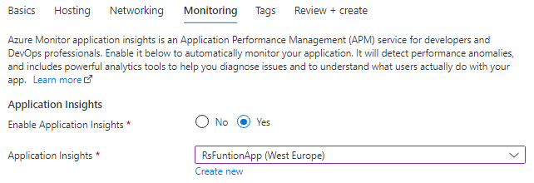
Creating a Function App

Slide 7
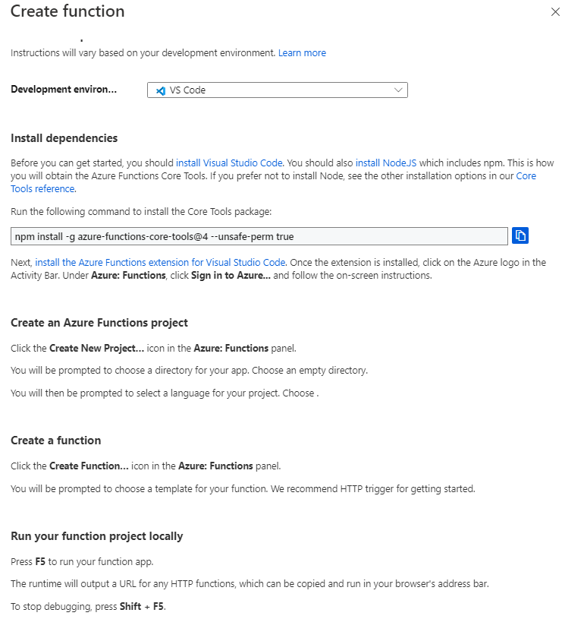
Creating a Function

Slide 8
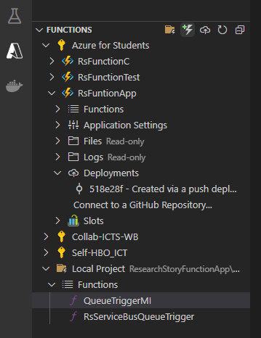
Creating a Function
Create project
Create function
Deploy to azure

Slide 9
Deploying a Function

Slide 10
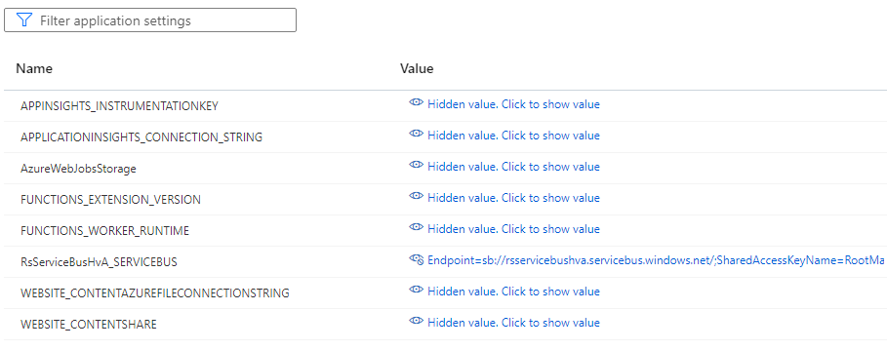
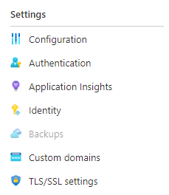
Connections
Configutaion

Slide 11
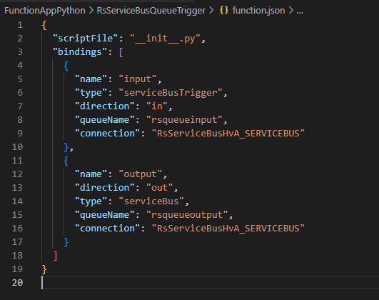
Connections
Configutaion

Slide 12
Projectanalyse, dia 4
Voorbeeld
Azure service
Input/Trigger
Function app
Azure service
Input
Azure service

Slide 13
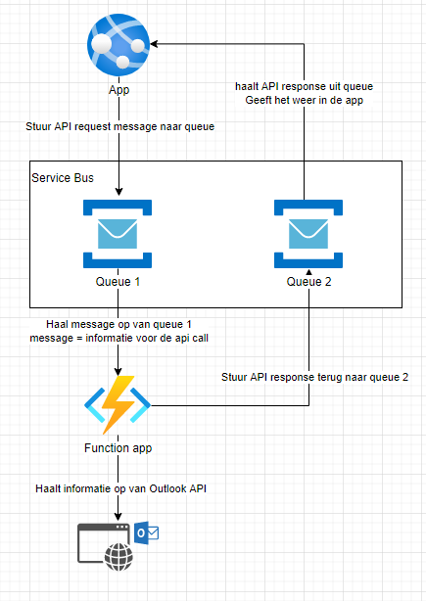
Project voorbeeld

Slide 14
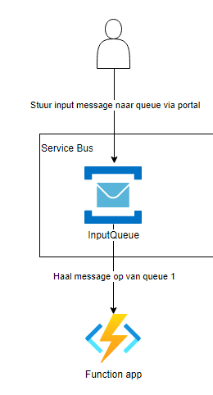
Default voorbeeld

Slide 15
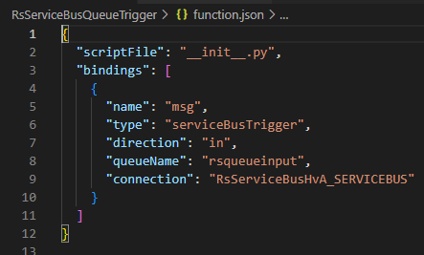
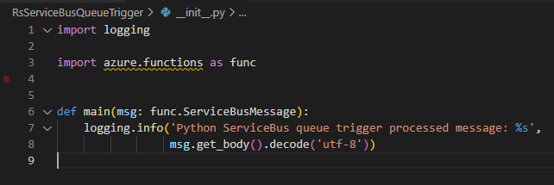
Code + Function.json
Default

Slide 16
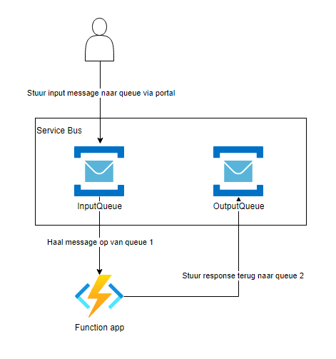
Code + Function.json
Service Bus demo

Slide 17
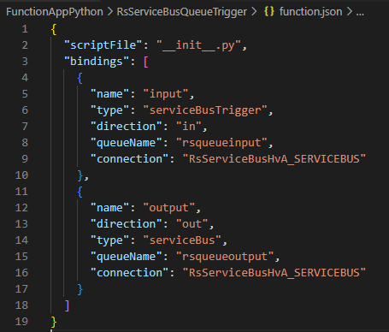
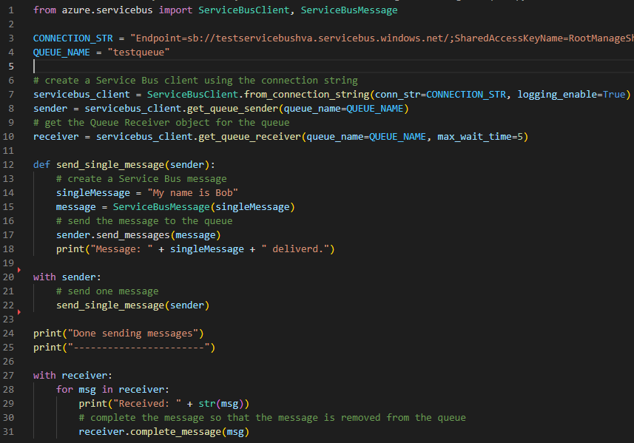
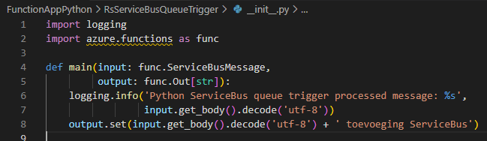
Code + Function.json
Service Bus demo

Slide 20
The ENd

